Slide 1


WORK REPORT
New 4.5MW Wind Turbine
Kelmarsh Wind Farm Extension
Report
05/2023
S2280536 Yifan Chen
Notes:
Hello, My name is Yifan Chen. And this presentation is my report for my kelmarsh wind farm extension work.

Slide 2
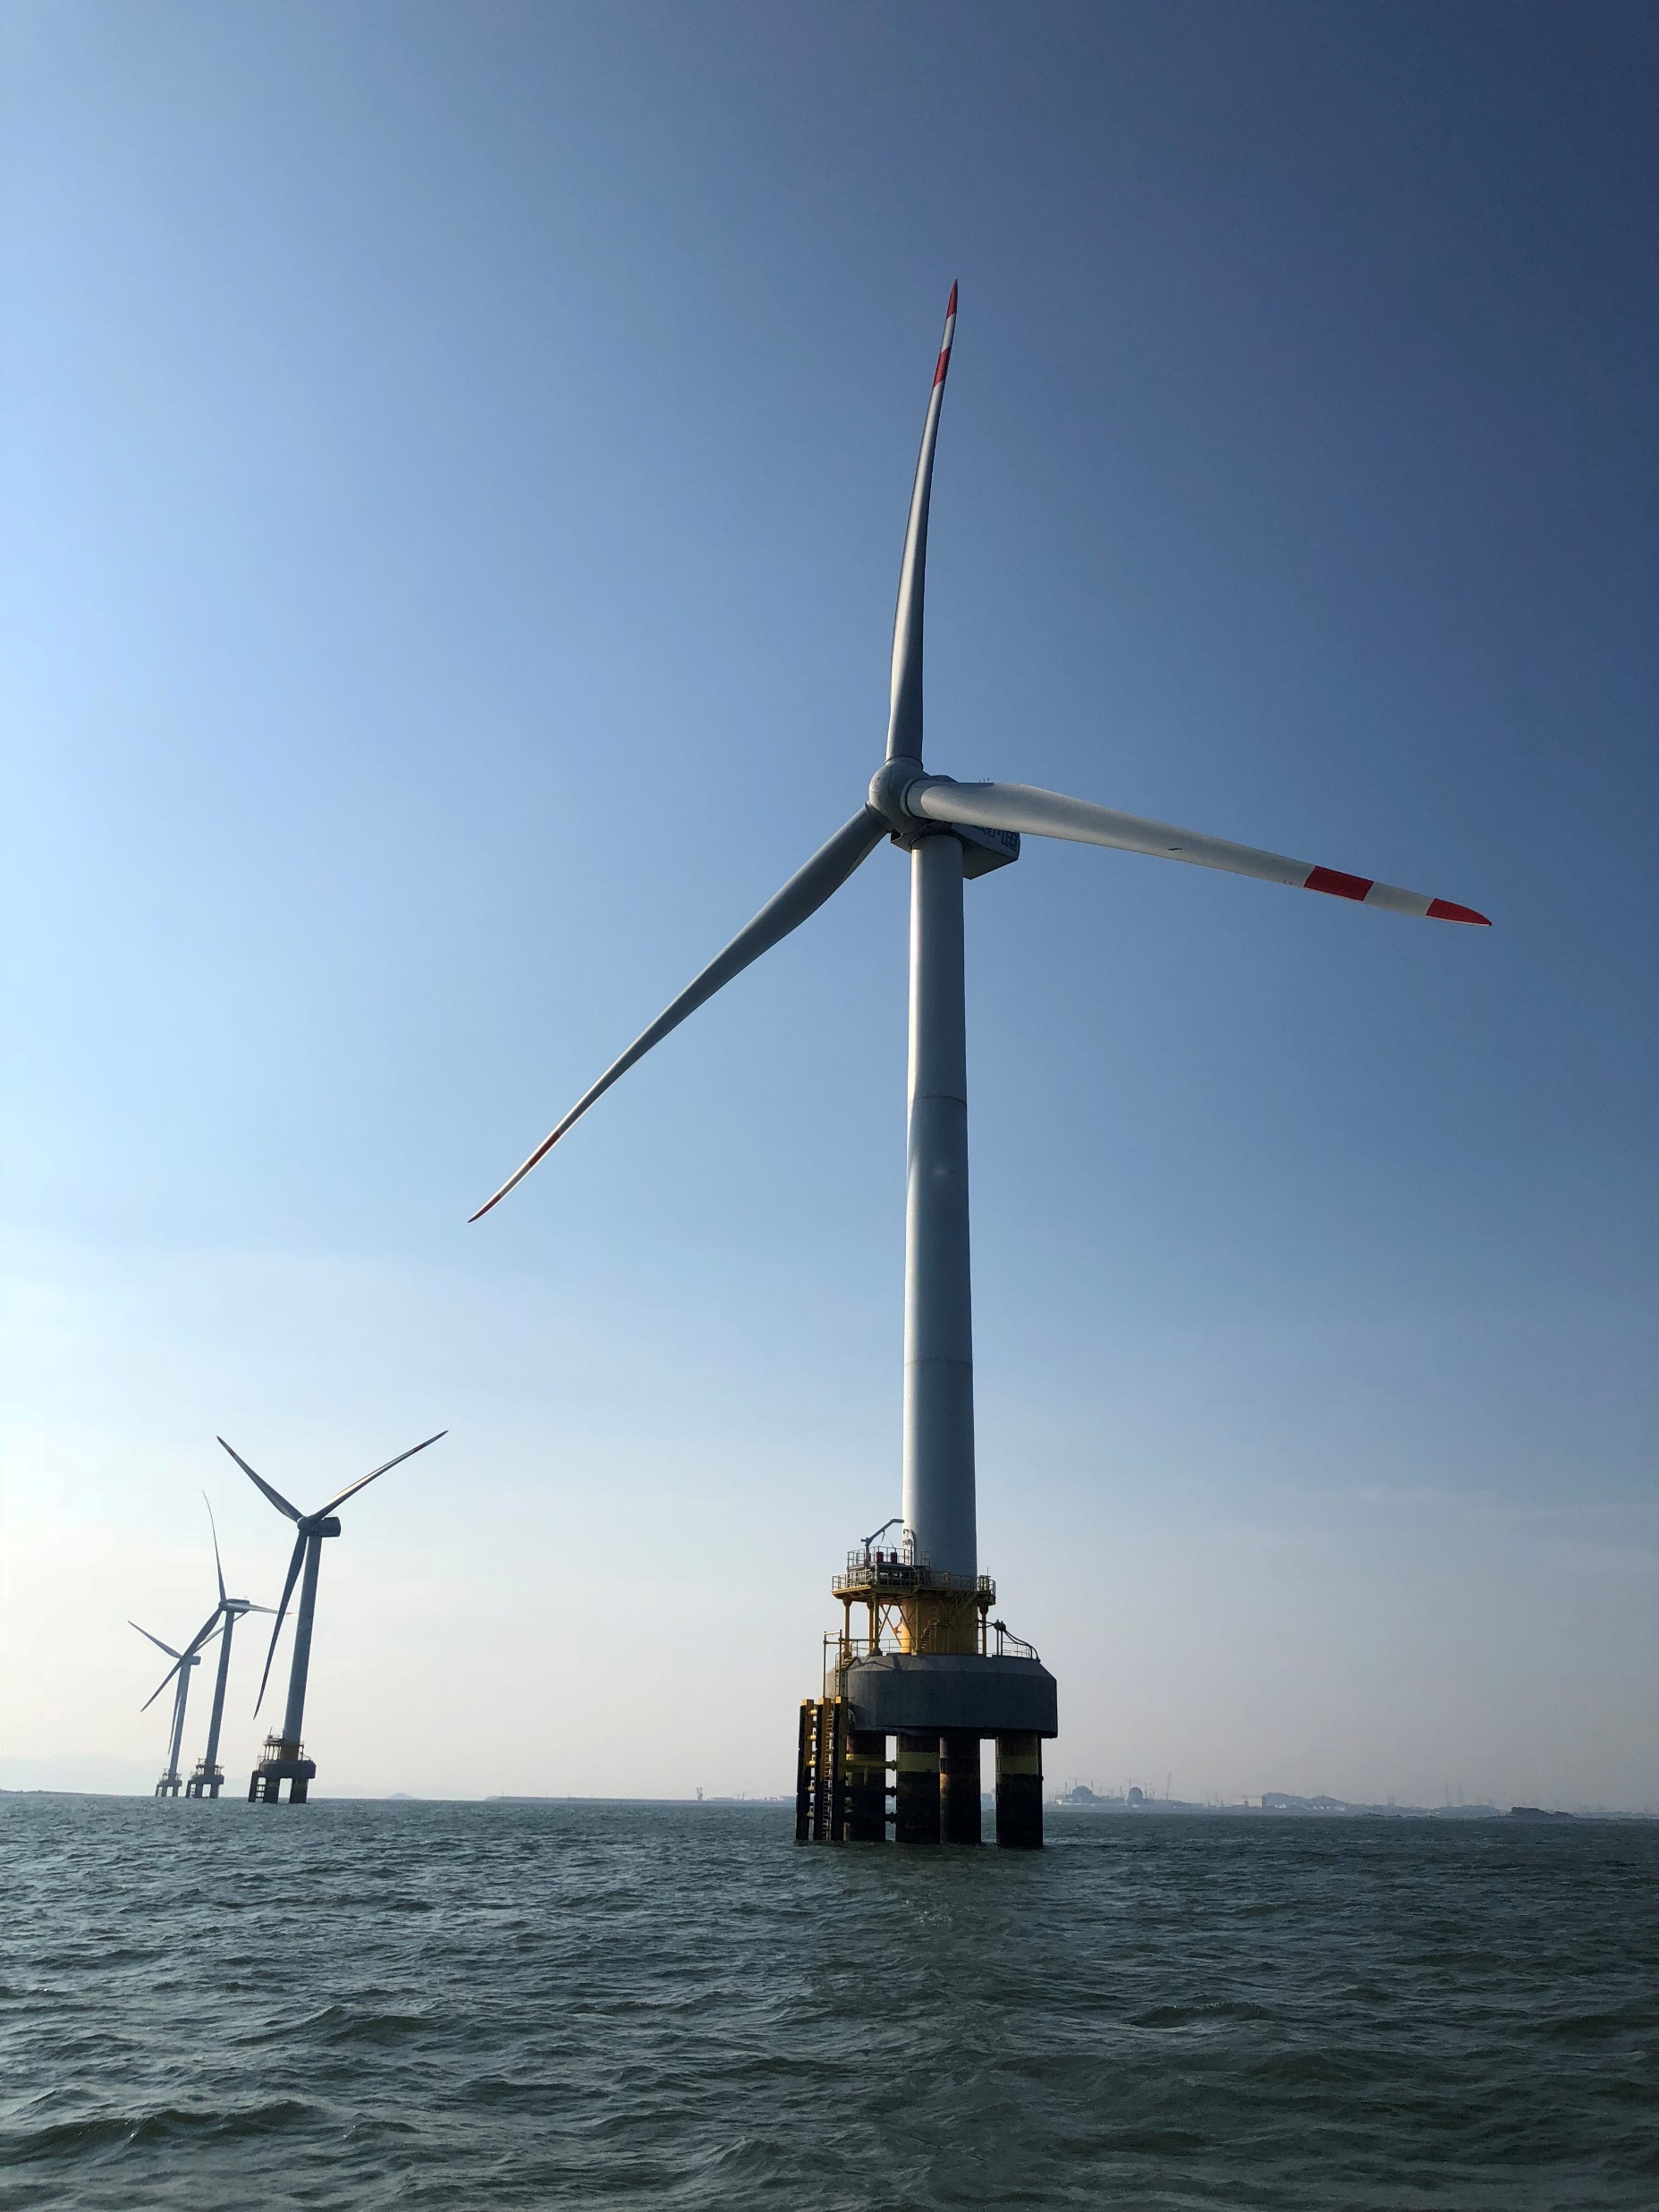
1
Site Characteristics
4
Cost Estimation
2
5
CONTENTS
Turbine Selection
Uncertainties
3
New Turbine Design
Notes:
During my presentation, I will briefly go through the work I have done in these five parts.
The site Characteristions at Kelmarsh.
The wind turbine selection for the new wind turbine yet to be built.
The design for the new wind turbine.
the cost estimation for the new wind turbine
And finally, the uncertainties in this project.

Slide 3
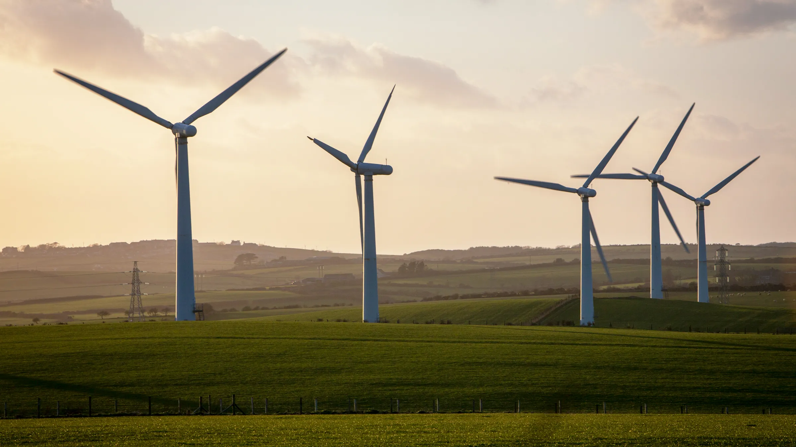
1
PART ONE
Site Characteristics
Notes:
Part one, site characteristics at kelmarsh

Slide 4
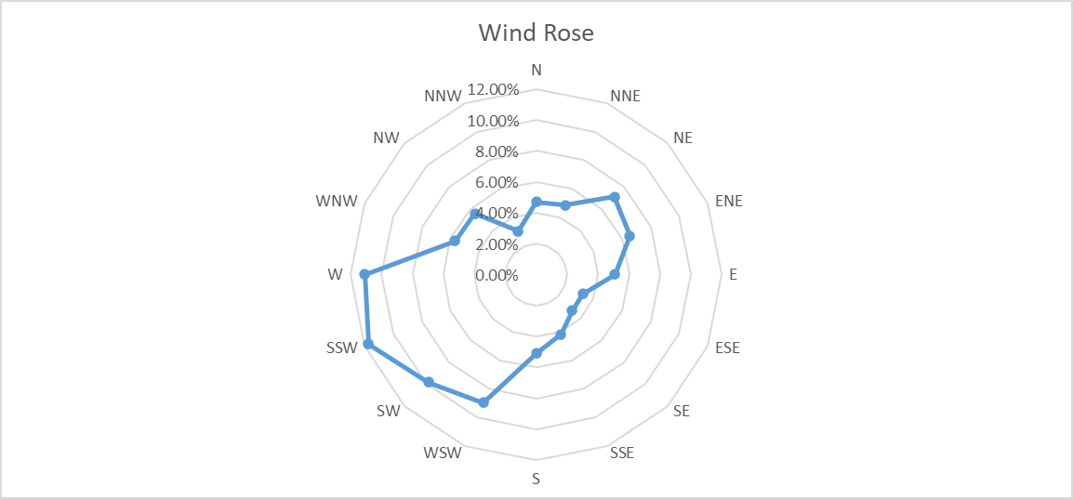
Wind Rose
Most of the wind comes from southwest direction.
The orientation of the wind turbines should face southwest.
Notes:
The first thing I want to present is the wind rose graph at kelmarsh. this wind rose is based on the daily wind direction information gathered at kelmarsh. It shows that Most of the wind comes from southwest direction in kelmarsh, thich indicates that this should be the direction the new wind turbines should be facing.

Slide 5
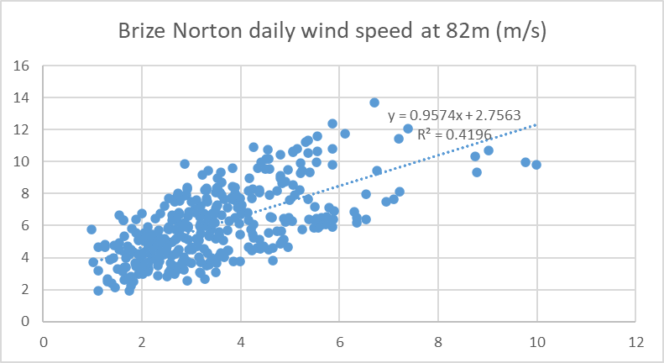
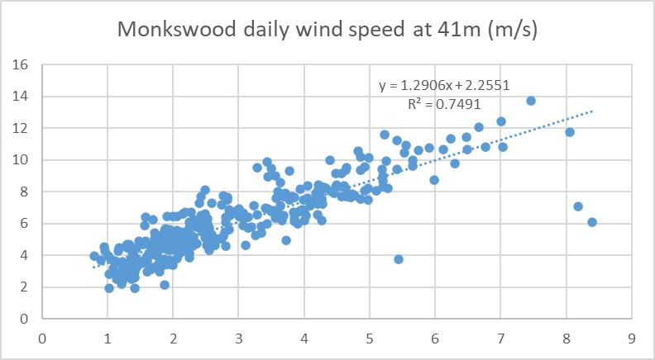
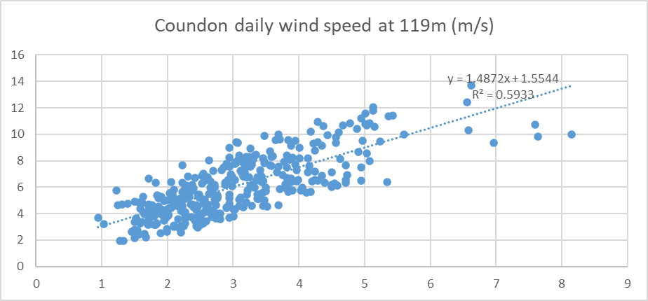
Measure Correlate Predict Strategy
Establish a linear relationship between wind speed at target site and reference sites.
From the results, we can determine that the wind characteristic at Monksood has the highest similarity.
We can predict the long term average annual wind speed at Kelmarsh at the height of 78.5m is 6.1875 m/s.
Notes:
The second thing is to use Measure Correlate Predict Strategy to Establish a linear relationship between wind speed at kelmarsh and reference sites. In this project, the reference sites are brize Norton, monkswood and coudon.
From the results, we can determine that the wind characteristic at Monksood has the highest similarity since it has the highest coefficient of determination aka r-squared.
We can predict the long term average annual wind speed at Kelmarsh at the height of 78.5m is 6.1875 m/s.

Slide 6
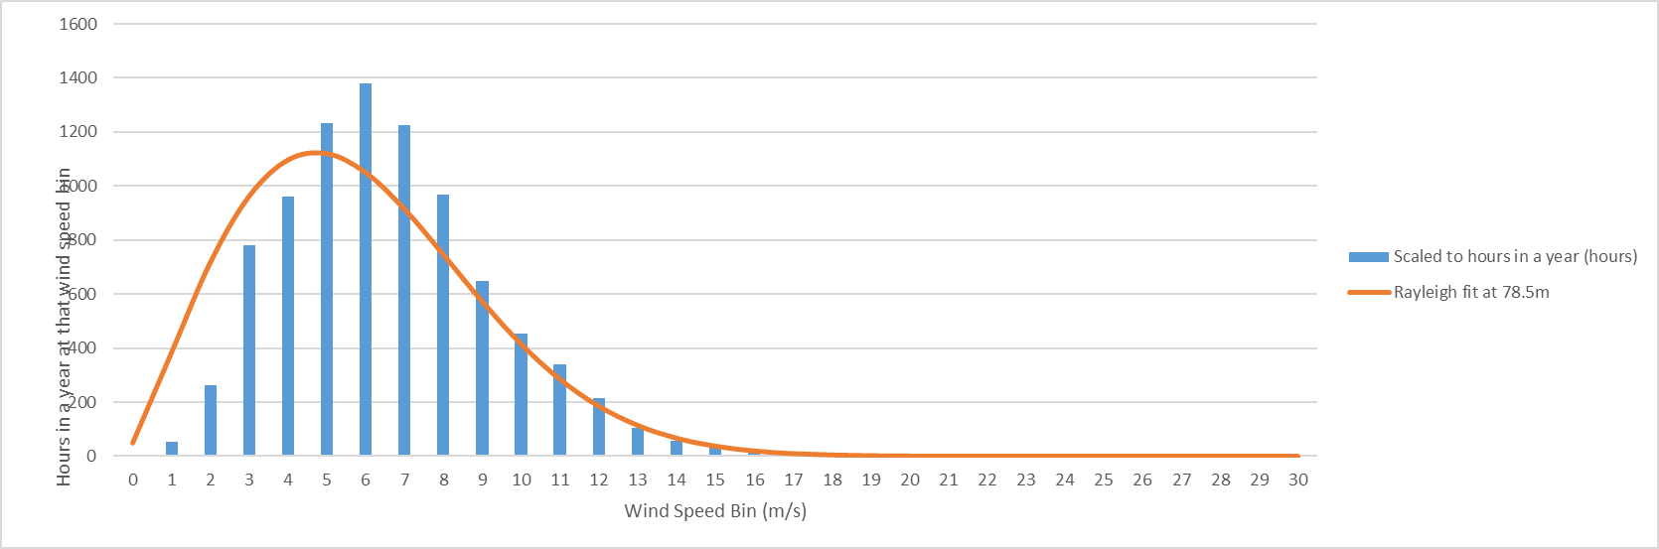
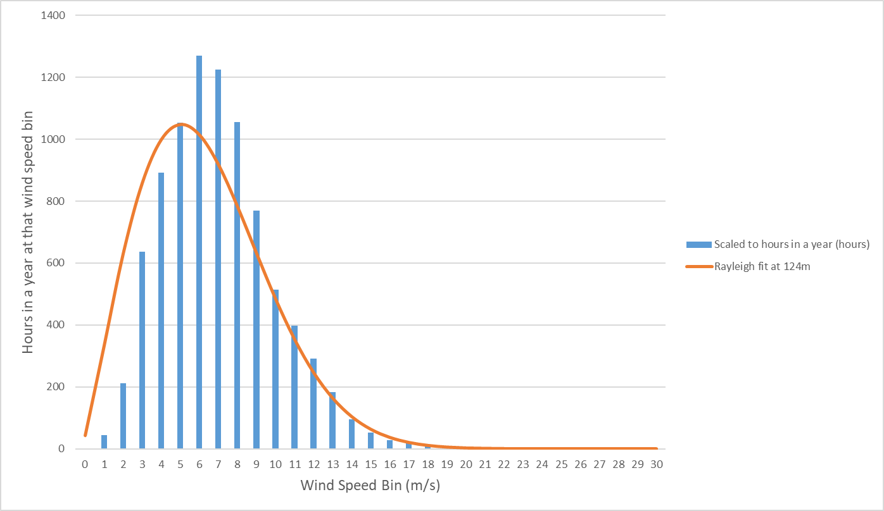
P90 Wind Speeds
P90 wind speed at 78.5m in Kelmarsh is 5.89m/s.
P90 wind speed at 124m in Kelmarsh is 6.32m/s.
Notes:
The last thing I want to present in part one is P90 wind speed at kelmarsh. this figure gives us the wind speed to be exceeded with 90% probability at kelmarsh.
The result shows that that 90% of annual wind speed at is about 5.89 m/s at the height of 78.5m, and 6.32m/s at 124m.

Slide 7
2
PART TWO
Turbine Selection
Notes:
Part two is The wind turbine selection as reference for the new wind turbine yet to be built.

Slide 8
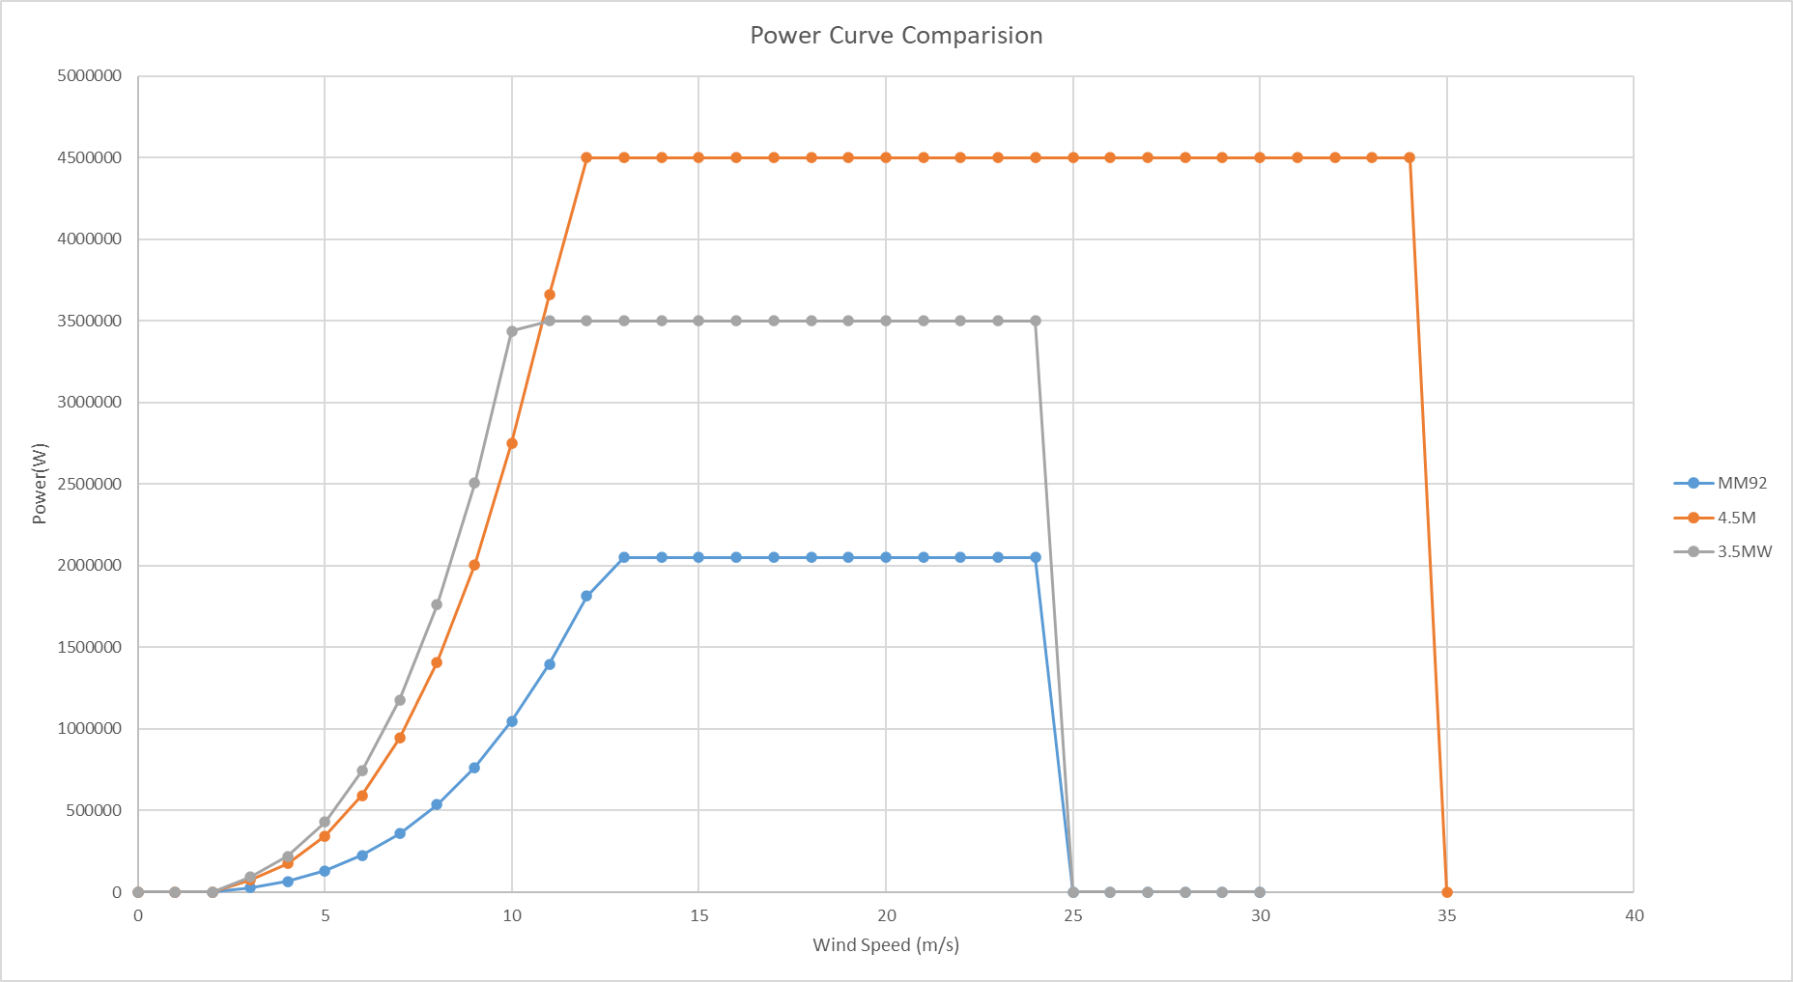
Power Curve Comparision
Wind Turbine Selection:
Between 3.5MW Design and 4.5MW Design, 4.5MW Design is a better pick!
4.5MW Design has the same range between cut in wind speed and rated wind speed as the old MM92 turbines. It is more likely that it will fit better in the weather condition in Kelmarsh wind farm.
4.5MW Design has a smaller radius for its blades. Taking the site location into account, it has less affect on the local residents.
Notes:
The existing turbines are 6 2.05MW turbines. By comparing the power curve of a 3.5MW design and a 4.5MW design, I think that the 4.5MW Design is a better pick!
4.5MW Design has the same range between cut in wind speed and rated wind speed as the old MM92 turbines. It is more likely that it will fit better in the weather condition in Kelmarsh wind farm.
4.5MW Design has a smaller radius for its blades. Taking the site location into account, it has less affect on the local residents.
in order to meet the requirement of energy production, 3 4.5MW design turbines are needed.

Slide 9
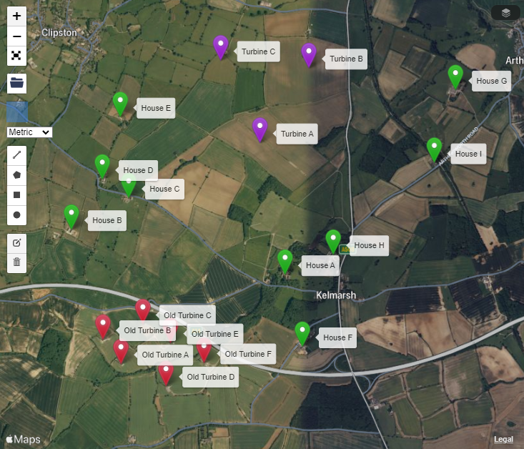
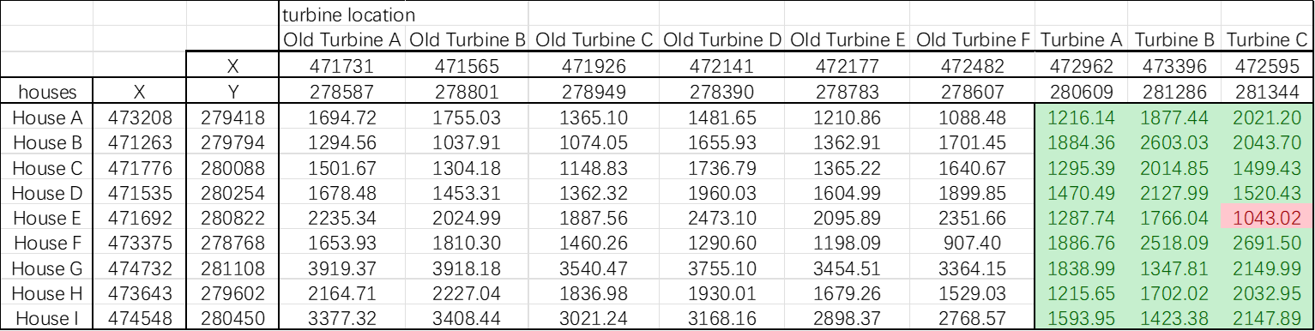
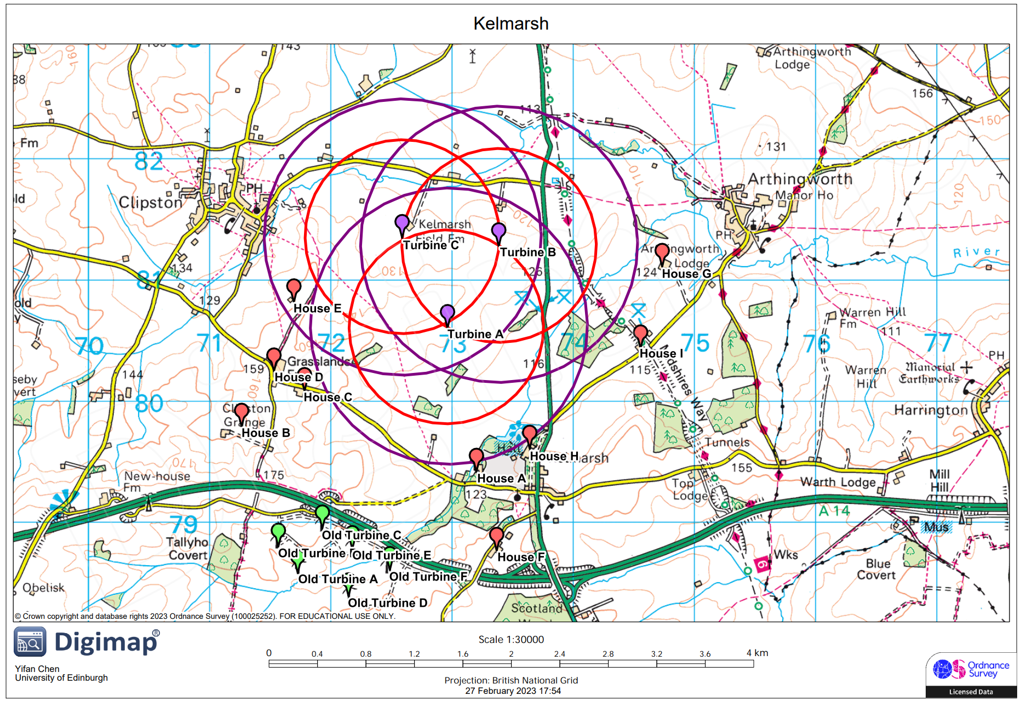
Location of New Turbines
House E seems to be within the distance of 10D of Turbine C.
There will be some shadow flicker influence.
By avoiding affecting the residents, the Turbine C should be turn off during that period of time.
After checking the geographic environment of Kelmarsh on the map, the north part of Kelmarsh is a good location for new turbines.
Notes:
After checking the geographic environment of Kelmarsh on the map, the north part of Kelmarsh is a good location for new turbines.
when we are trying to find the site to place the new wind turbines, we have to consider the shadow flicker influence on the nearby residents.
From the calculation, we can see that House E seems to be within the distance of 10D of Turbine C.
which means that There will be some shadow flicker influence.
By avoiding affecting the residents, the Turbine C should be turn off during that period of time.

Slide 10
Noise Propagation
The UK wind farm noise to be limited to an absolute level of 35-40 dB.
From calculation, all results lies within limit.
Notes:
we also have to consider the noise produced by the wind turbines.
The UK wind farm noise to be limited to an absolute level of 35-40 dB.
From calculation, all results lies within limit.
although some of the results also reach 40dB, most of the wind comes from southwest direction. there are no nearby houses at The downdraft of the wind turbine, so the affects caused by noise are limited.

Slide 11
3
PART THREE
New Turbine Design
Notes:
Part 3 is the design for the new wind turbine.

Slide 12
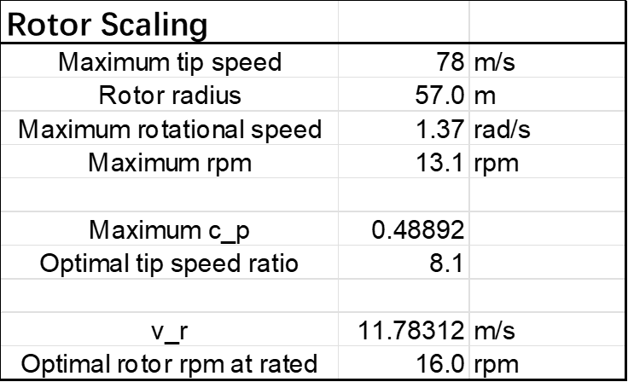
Scaling for New Wind Turbine
New wind turbine is scaled down from a previously designed 5MW turbine.
Scale factor is 0.9047.
Scale factor is the ratio of the length of new blade over the NREL 5 MW blade.
Scale factor is used to global scale.
Notes:
This design for the new wind turbine is by scaling down from a previously designed 5MW turbine.
Scale factor is the ratio of the length of new blade over the NREL 5 MW blade.
from calculation, we can know that the scale factor is 0.9047.
this scale factor will be used to global scale.

Slide 13
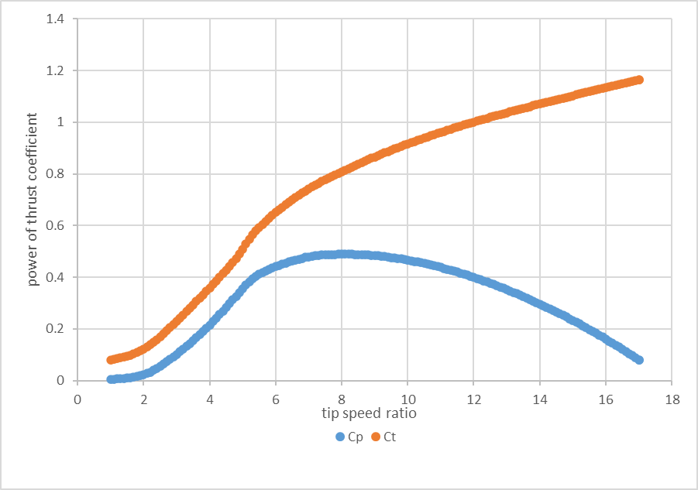
Cp & Ct of the New Wind Turbine
From simulation:
The optimal tip speed ratio is 8.1.
The maximum Cp is 48.89%.
Notes:
From the simulation, we can also identify that
the The optimal tip speed ratio is 8.1.
and The maximum Cp is 48.89%.

Slide 14
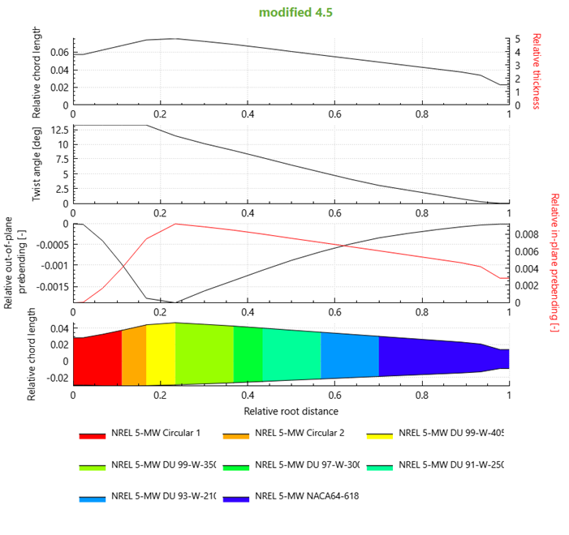
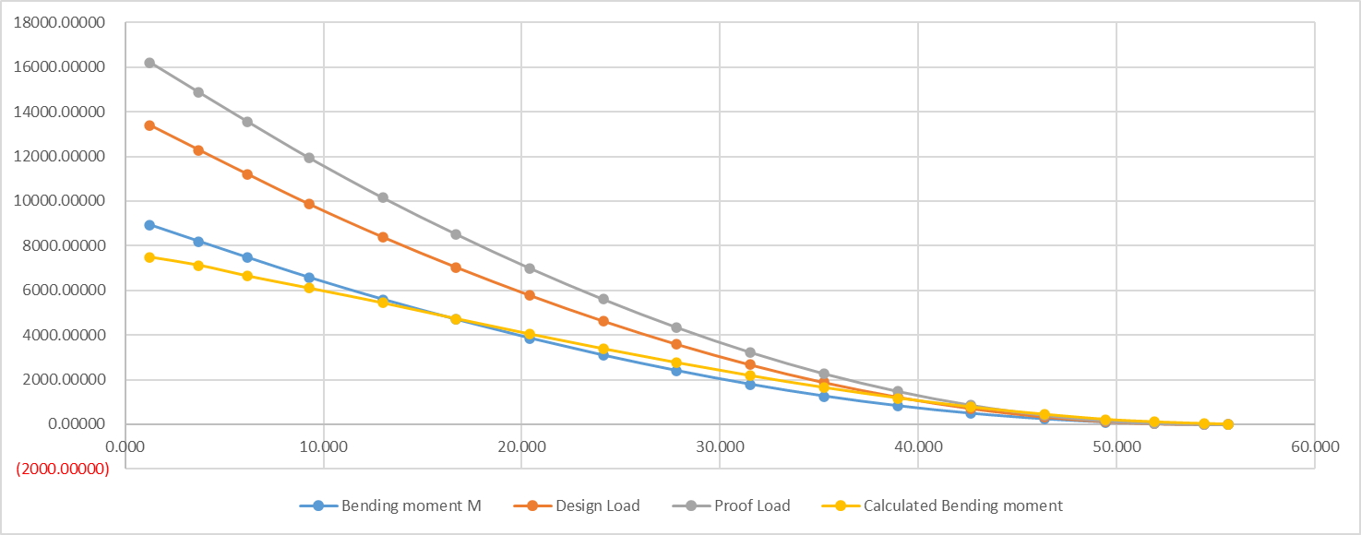
Blade Design
From simulation, the bending moment can get as big as 8927.45 kNm.
From calculation, the bending moment can get as big as 7487.87 kNm.
The proof load which is used for blade design is obtained by x1.5 and x1.21 of the simulated bending moment.
Notes:
the second part of the design is the blade design.
From simulation, the bending moment can get as big as 8927.45 kNm.
From calculation, the bending moment can get as big as 7487.87 kNm.
The proof load which is used for blade design is obtained by x1.5 and x1.21 of the simulated bending moment.

Slide 15
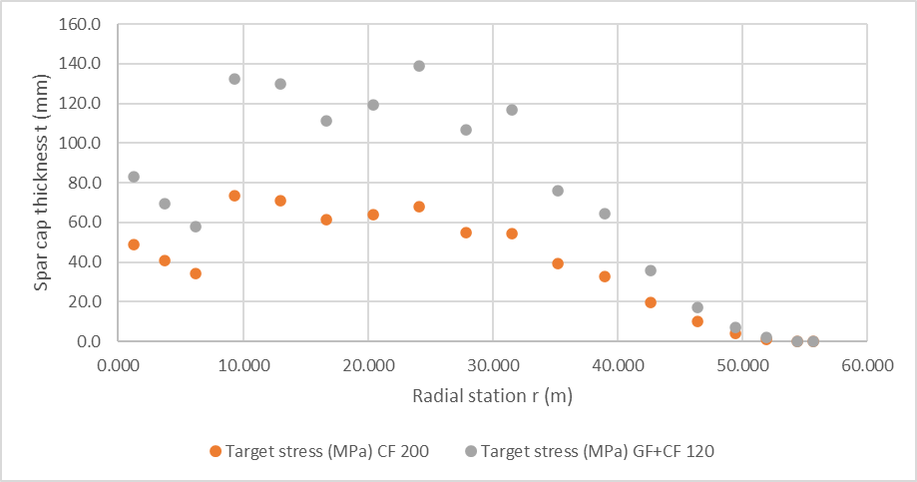
Blade Design
The mass for only CF is 3613.74kg. The cost for the material is around 86.73 k£ .
The mass for 2/3 GF and 1/3 CF is 7847.85kg. The cost for the material is around 70.61 k£ .
If we only consider these two options, better to just use CF.
Notes:
Now we have to design the spar cap, since spar cap is the most important part of a turbine blade. after calculating for the thickness for the spar cap, we can obtain the mass of the spar cap by determining the material we are gonna use for the spar cap.
In my design, I use two options, one is to only use carbon fiber, the other one is to use 2/3 of glass fiber and 1/3 of carbon fiber.
The mass for only CF is 3613.74kg. The cost for the material is around 86.73 k£ .
The mass for 2/3 GF and 1/3 CF is 7847.85kg. The cost for the material is around 70.61 k£ .
If we only consider these two options, better to just use CF. since the mass is less than half of the other option, while the cost is about 18% more.

Slide 16
Tower Design
The height of the tower is 78.252m from global scaling in simulation.
The tower is made of about 258t of steel.
The cost for the steel is around 119.1 k£.
Notes:
the next part is the tower design. we can obtain the information of the tower from simulation after global scaling.
The height of the tower is 78.252m after global scaling in simulation.
The tower is made of about 258t of steel.
The cost for the steel is around 119.1 k£.

Slide 17
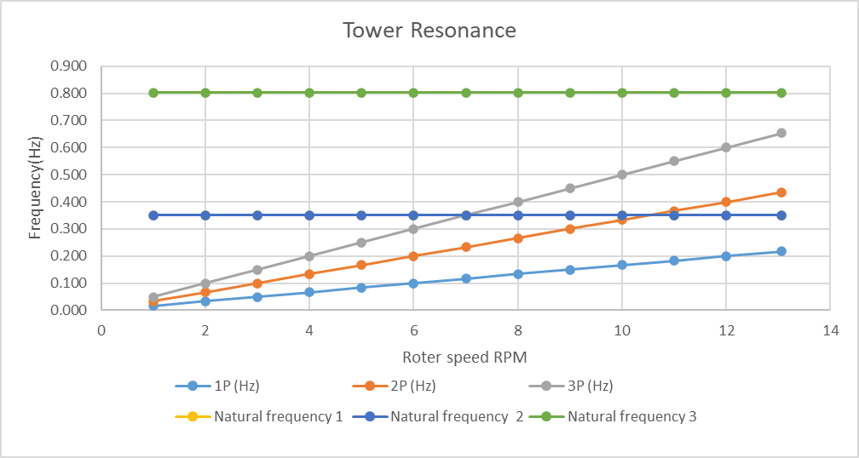
Tower Design
The blade flapwise vibration natural frequency is 0.35Hz.
The harmonic frequency 1P crossovers over with natural frequency 1&2 at 7rpm. The 2P crossovers with natural frequency 1&2 at around 10.8rpm.
We need to control the rotational speed of the blade to quickly skip these two rotational speed.
Notes:
The blade flapwise vibration natural frequency is 0.35Hz.
The harmonic frequency 1P crossovers over with natural frequency 1&2 at 7rpm. The 2P crossovers with natural frequency 1&2 at around 10.8rpm.
We need to control the rotational speed of the blade to quickly skip these two rotational speed to avoid resonance.

Slide 18
Generator Design
The new generator is scaled from a 3MW DDPMG.
The generator “radius/axial length”ratio is set to be 2.
The electromagnetic shear stress is to be 4MPa.
The new generator has 93 pole pairs.
The cost for raw material is around 226.96 k£.
Notes:
as for the generator design.
The new generator is scaled from a 3MW direct drive permanent magnet generator.
The generator “radius/axial length”ratio is set to be 2.
The electromagnetic shear stress is to be 4MPa.
after calculation, we can know that The new generator has 93 pole pairs.
and The cost for raw material is around 226.96 k£.

Slide 19
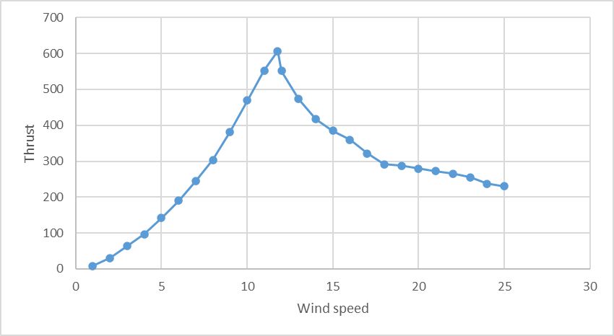
Foundation Design
The concrete plinth and buried depth is set to be 1.5m and 1.8m respectively.
The base dimension is about 14.4m in this case.
245m³ of concrete and 40t of steel bars are needed.
The cost for material is estimated around 46.7 k£。
Notes:
during foundation design
The concrete plinth and buried depth is set to be 1.5m and 1.8m respectively.
in this case , we can calculate for the base dimension. The base dimension is about 14.4m.
from the results , we can see that about 245m³ of concrete and 40t of steel bars are needed.
The cost for these amount of materials is estimated around 46.7 k£。

Slide 20
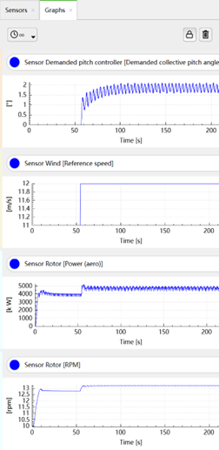
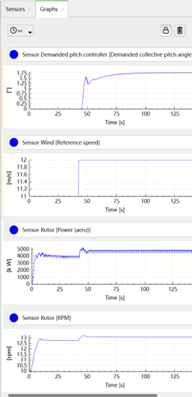
Controller Design
The method used to define the proportional and integral gains is Ziegler–Nichols method.
The value of the proportional gain which allows the pitch angle to start producing divergent oscillations is 2.99s.
The period of the oscillations of this output is 3.523s.
Notes:
at last, it’s the controller design.
For this project, a PI controller is used.
The method used to define the proportional and integral gains for this PI controller is Ziegler–Nichols method.
The value of the proportional gain which allows the pitch angle to start producing divergent oscillations is 2.99s.
The period of the oscillations of this output is 3.523s.
By applying Ziegler–Nichols method, we can know that the final proportional gain is 1.3455 and the integral gain is 0.458.

Slide 21
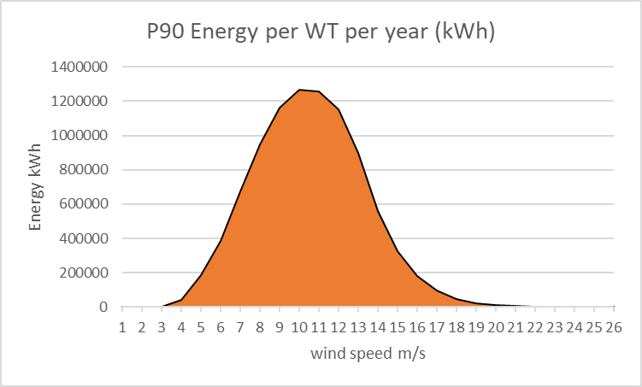
Energy Yield
The amount of kWh energy produced by one new wind turbine in a year is about 9.2 M.
The amount of kWh energy produced by total three wind turbines in a year is about 27.7 M.
Notes:
The amount of kWh energy produced by one new design wind turbine in a year is about 9.2 M.
The amount of kWh energy produced by total three new design wind turbines in a year is about 27.7 M.

Slide 22
4
PART FOUR
Cost Estimation
Notes:
part 4 is the cost estimation for the new wind turbine

Slide 23
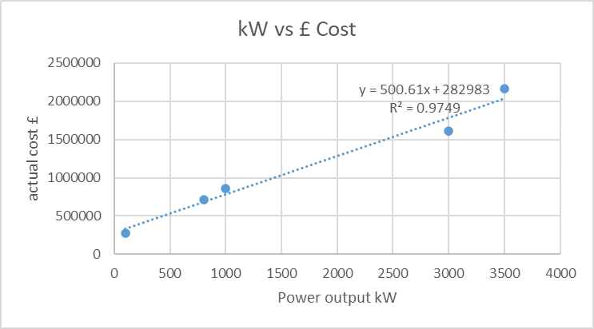
Cost Estimation
From 5 different rated power wind turbine, we can attempt to solve for the cost for 4.5MW wind turbine to approximate the spend.
From a linear fitting of the rated power of wind turbine and cost, the cost for a 4.5MW wind turbine is approximated to be 2.5 M£.
Notes:
From 5 different rated power wind turbine, we can attempt to solve for the cost of a 4.5MW wind turbine to approximate the spend.
From a linear fitting of the rated power of wind turbine and cost, the cost for a 4.5MW wind turbine is approximated to be 2.5 M£.

Slide 24
CapEx of the Wind Turbine
Turbine component cost estimates are derived from a 2015 Cost and Scaling report.
Total installed project capital expenditure in 2021 averaged is 1501 $/kW.
The total estimation capital expenditure for 4.5MW new wind turbine is 1.8 M£.
Notes:
Turbine component cost estimates are derived from a 2015 Cost and Scaling report.
Total installed project capital expenditure in 2021 averaged is 1501 $/kW.
The total estimation capital expenditure for 4.5MW new wind turbine is 1.8 M£.

Slide 25
5
PART FIVE
Uncertainties
Notes:
The final part of this report is the uncertainties in this project

Slide 26
Uncertainties
Location
Locations are picked using Websites. Errors can not be ignored
Scaling
The design of new wind turbine is mostly by scaling down from 5MW wind turbine.
Simulation
Data read from simulation can be unprecise.
Problems
Controller
Controller can be improved by using auto-tuning PID controller.
Cost
The price for materials and the exchange rate for different currencies are changing in real-time
Notes:
There are some uncertainties,
for example, the location of the new wind turbines.
Locations are picked using Websites. there will be quite an error.
the scaling of the wind turbine.
The design of new wind turbine is mostly by scaling down from 5MW wind turbine.
Different parts of design cannot directly share a same scale factor since there are not really highly linear.
during Simulation, the Data read from simulation can be unprecise.
Controller, the Controller can be improved by using auto-tuning PID controller.
the cost, The price for materials and the exchange rate for different currencies are changing in real-time

Slide 27
WORK REPORT
Thank you for your attention!
Report
05/2023
Notes:
this is the end of my report, Thank you for your attention!

